Slide 1
Game Development Practice: World Pitch Brief and Worldbuilding

Slide 2
I. Brief (Brian McDonald)
II. What is a world?
III. World superstructures
A) Time
B) Space
C) Genealogy
IV. World Substructures
A) Nature
B) Culture
C) Language
D) Mythology
E) Philosophy

Slide 3
Pitching a world
The world will be the setting for a game that you will develop next year, but also potentially for many interconnected stories. In particular, describe the world’s tone, its thematic resonances, and how it enables the mechanics of a game set within this world (e.g. Runeterra’s Fields of Justice exist to prevent world war through arena battle between champions; Azeroth exists to create a perpetual state of strife that permits tactical warfare, grinding, and player versus player battles; Nosgoth is a physically and spiritually broken world that requires platforming navigation by rebellious antiheroic protagonists).

Slide 4
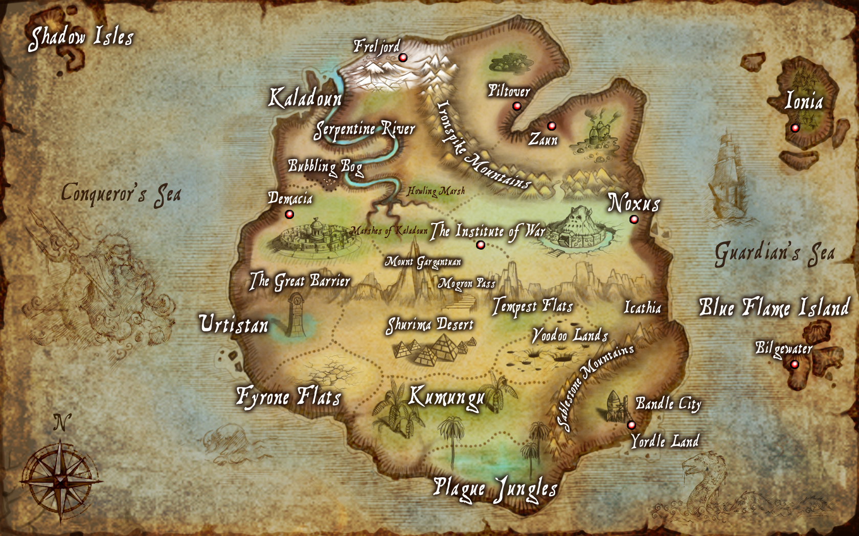
Runeterra’s Fields of Justice exist to prevent world war through arena battle between champions

Slide 5
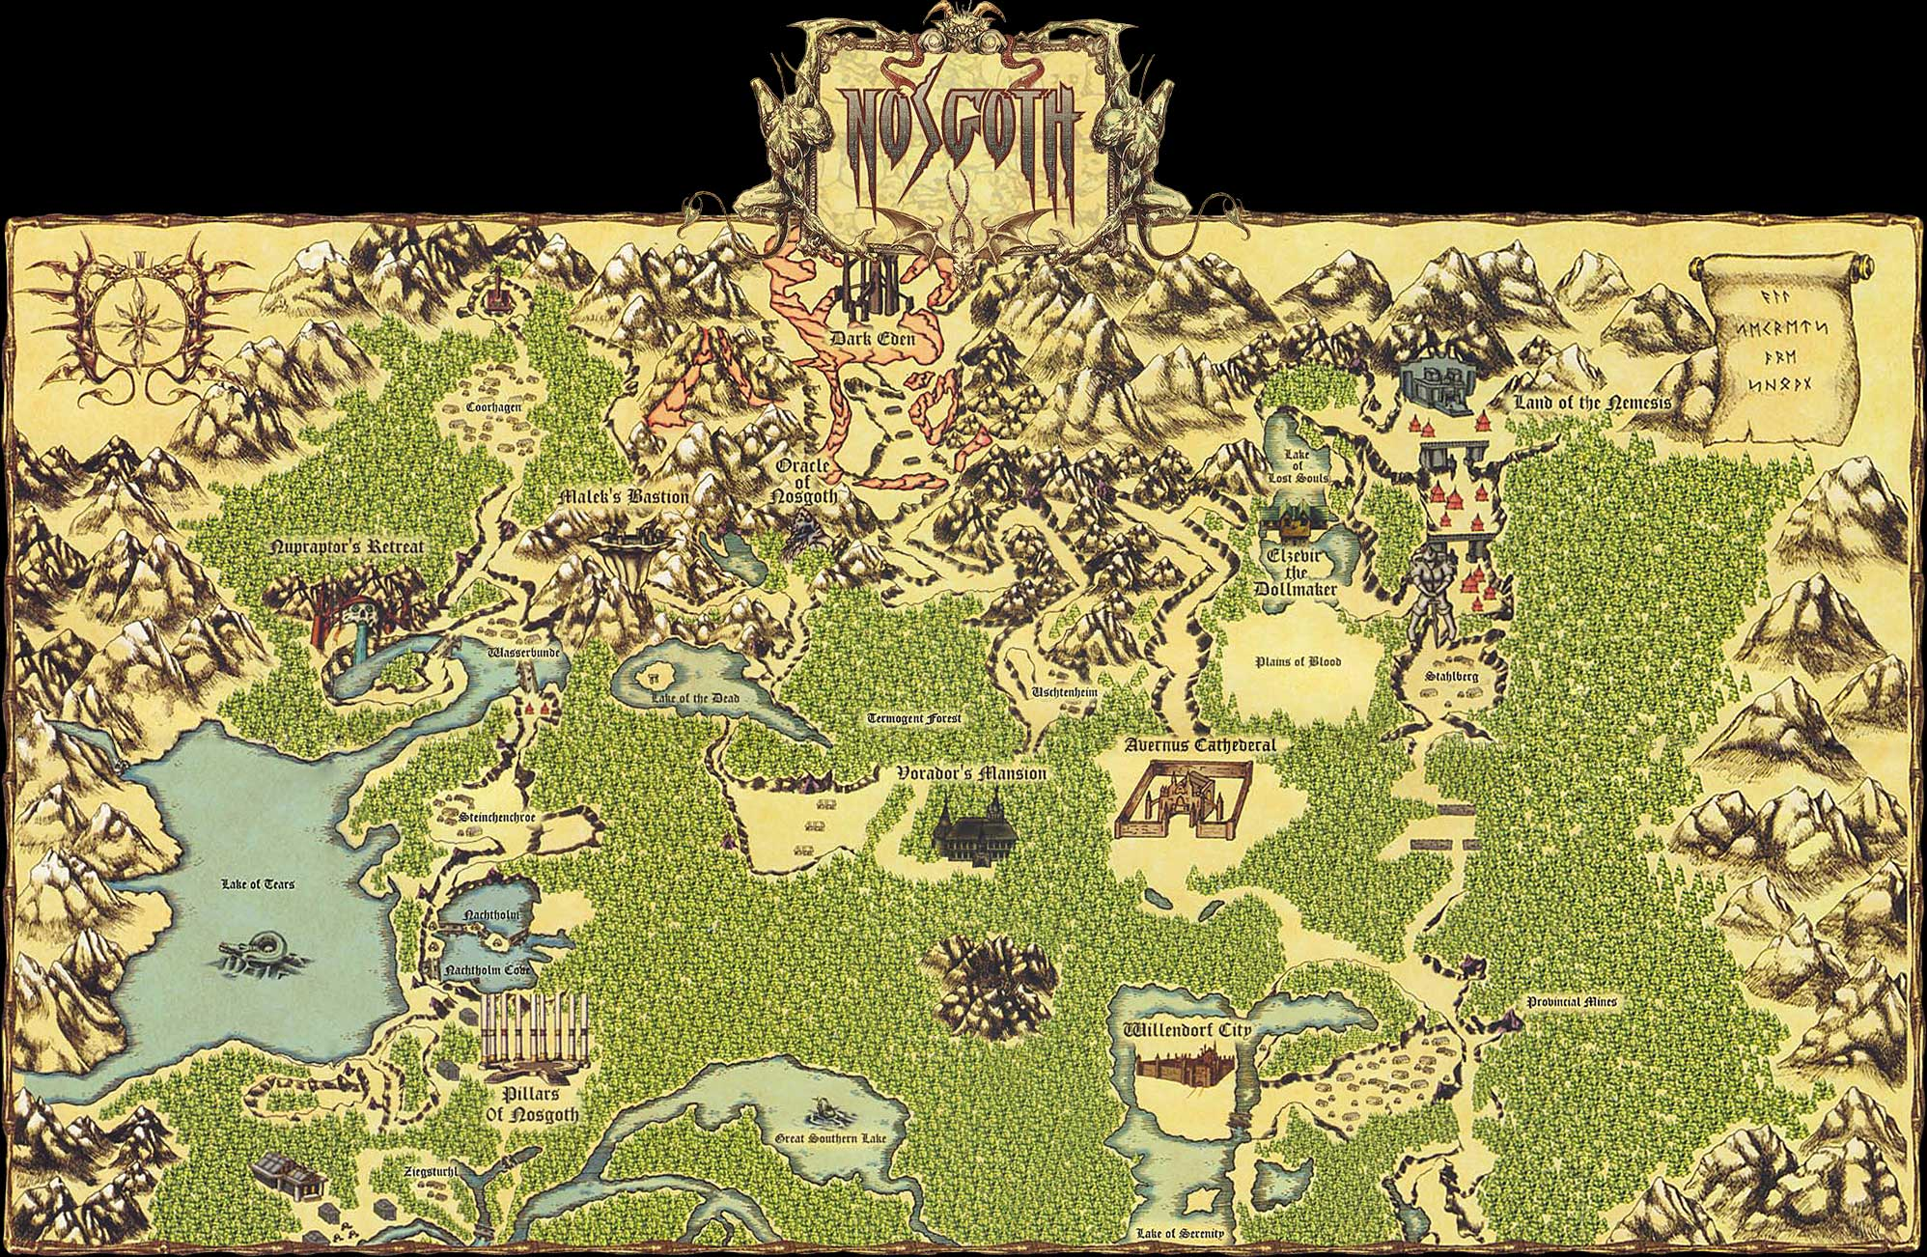
Nosgoth is a physically and spiritually broken world that requires platforming navigation by rebellious antiheroic protagonists

Slide 6
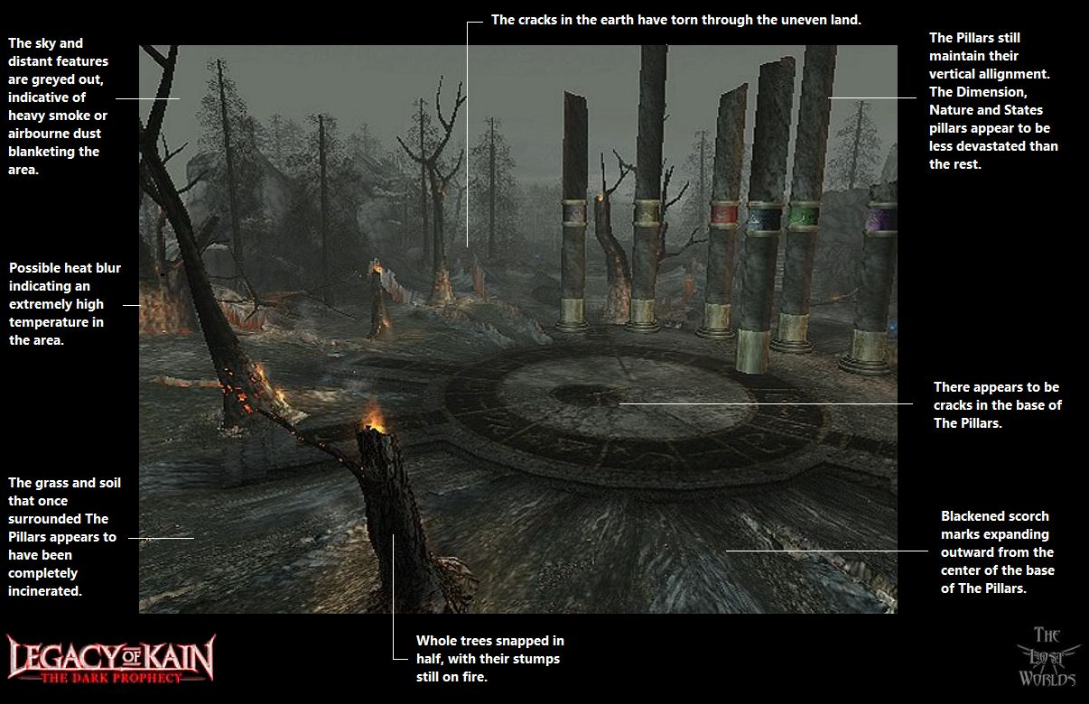
Broken pillars of Nosgoth (every detail meaningful in a cohesive world)

Slide 7
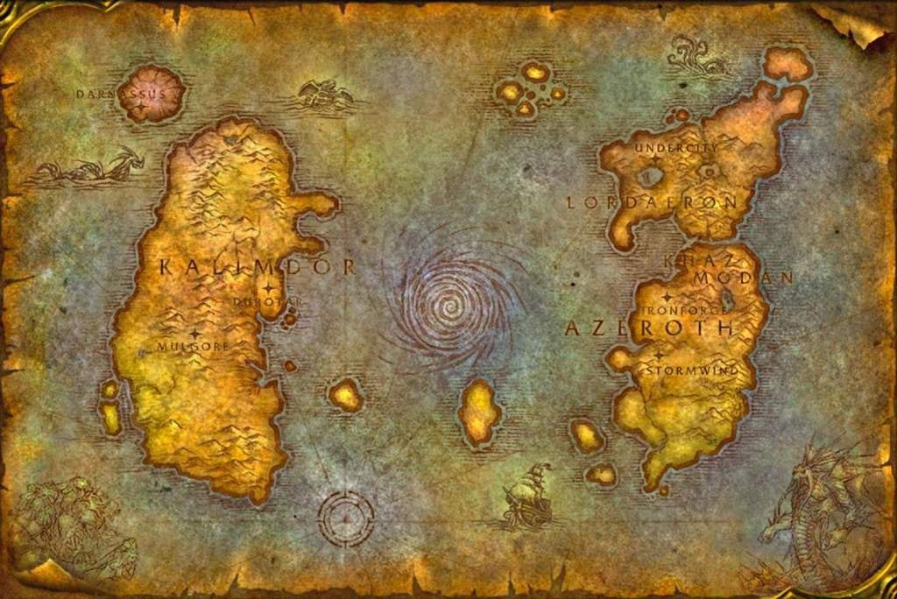
Azeroth exists to create a perpetual state of strife that permits tactical warfare, grinding, and player versus player battles)

Slide 8
Important aspects of a world pitch
Core experience (what the player does and feels in this world)
Tone (the emotions the world conveys through mood and atmosphere)
Themes (what the world is about philosophically)
Physical structure and geography
Civilizations
Political factions
Religion and mythology
Technology

Slide 9
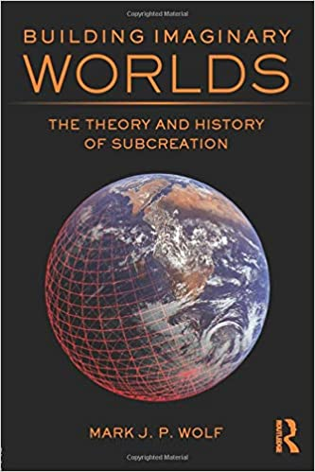
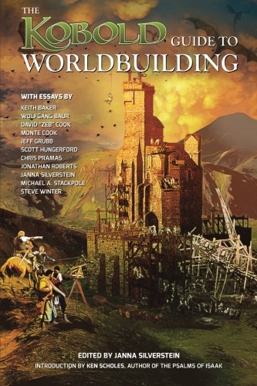

Slide 10

Worlds are organized by structures (the piece or parts of your pitch)

Slide 11
We understand secondary worlds through parallels to our primary world
We use the primary world defaults when not given other information
We understand the world through structures that “place individual facts and details into the larger contexts needed for them to be fully understood” (154)

Slide 12
Superstructures
Time
Space
Genealogy (can be extended into ontology, i.e. the underlying structure of what is in the world)

Slide 13
Infrastructures (or substructures)
Nature
Culture
Language
Mythology
Philosophy

Slide 14
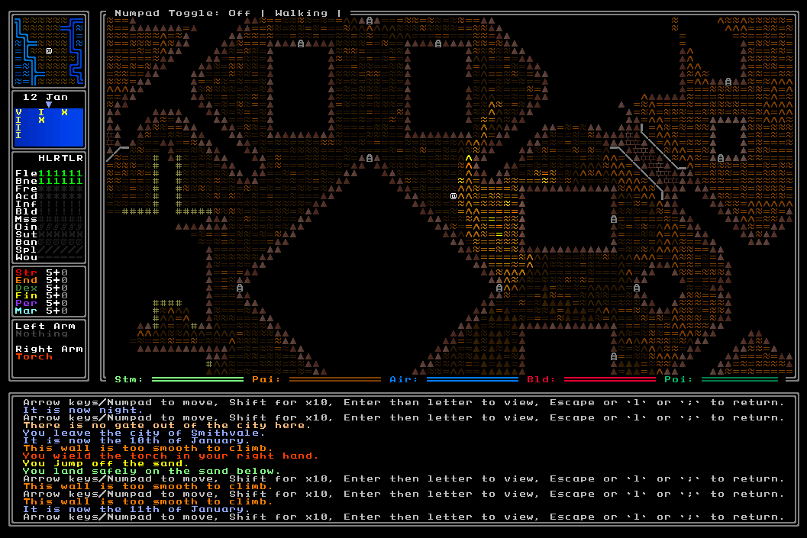

Slide 15
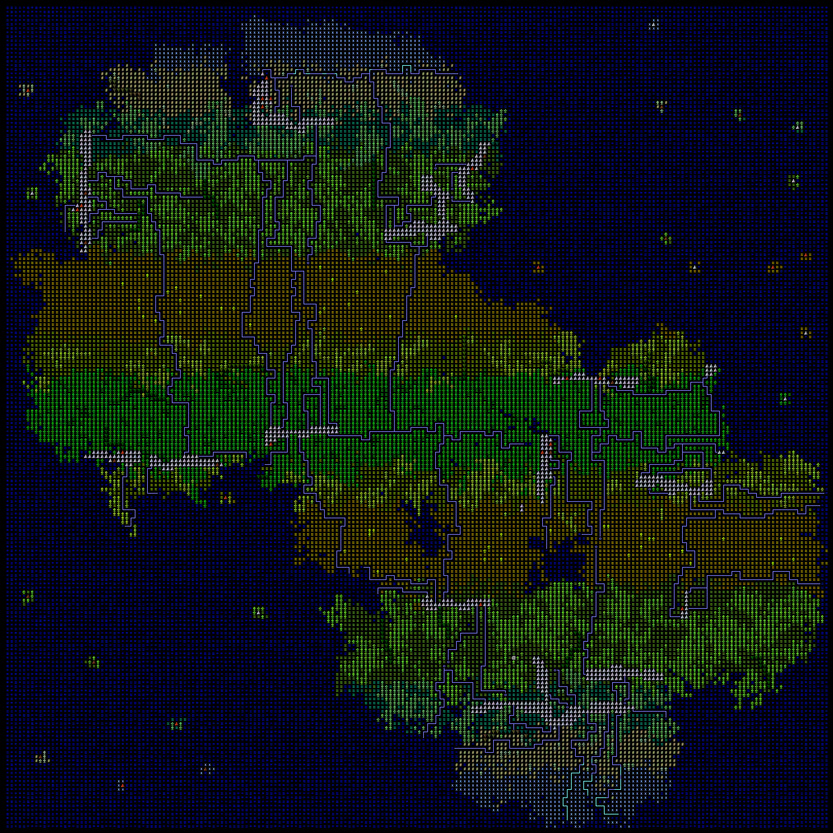

Slide 16
“All of the different infrastructures must also fit together consistently if world gestalten are to occur” (194).
In software terms, system integration

Slide 17
“Each of these has its organizational tools”

Slide 18
“Space in which things can exist and events can occur”

Slide 19
“Maps structure and connect a world’s locations together”

Slide 20
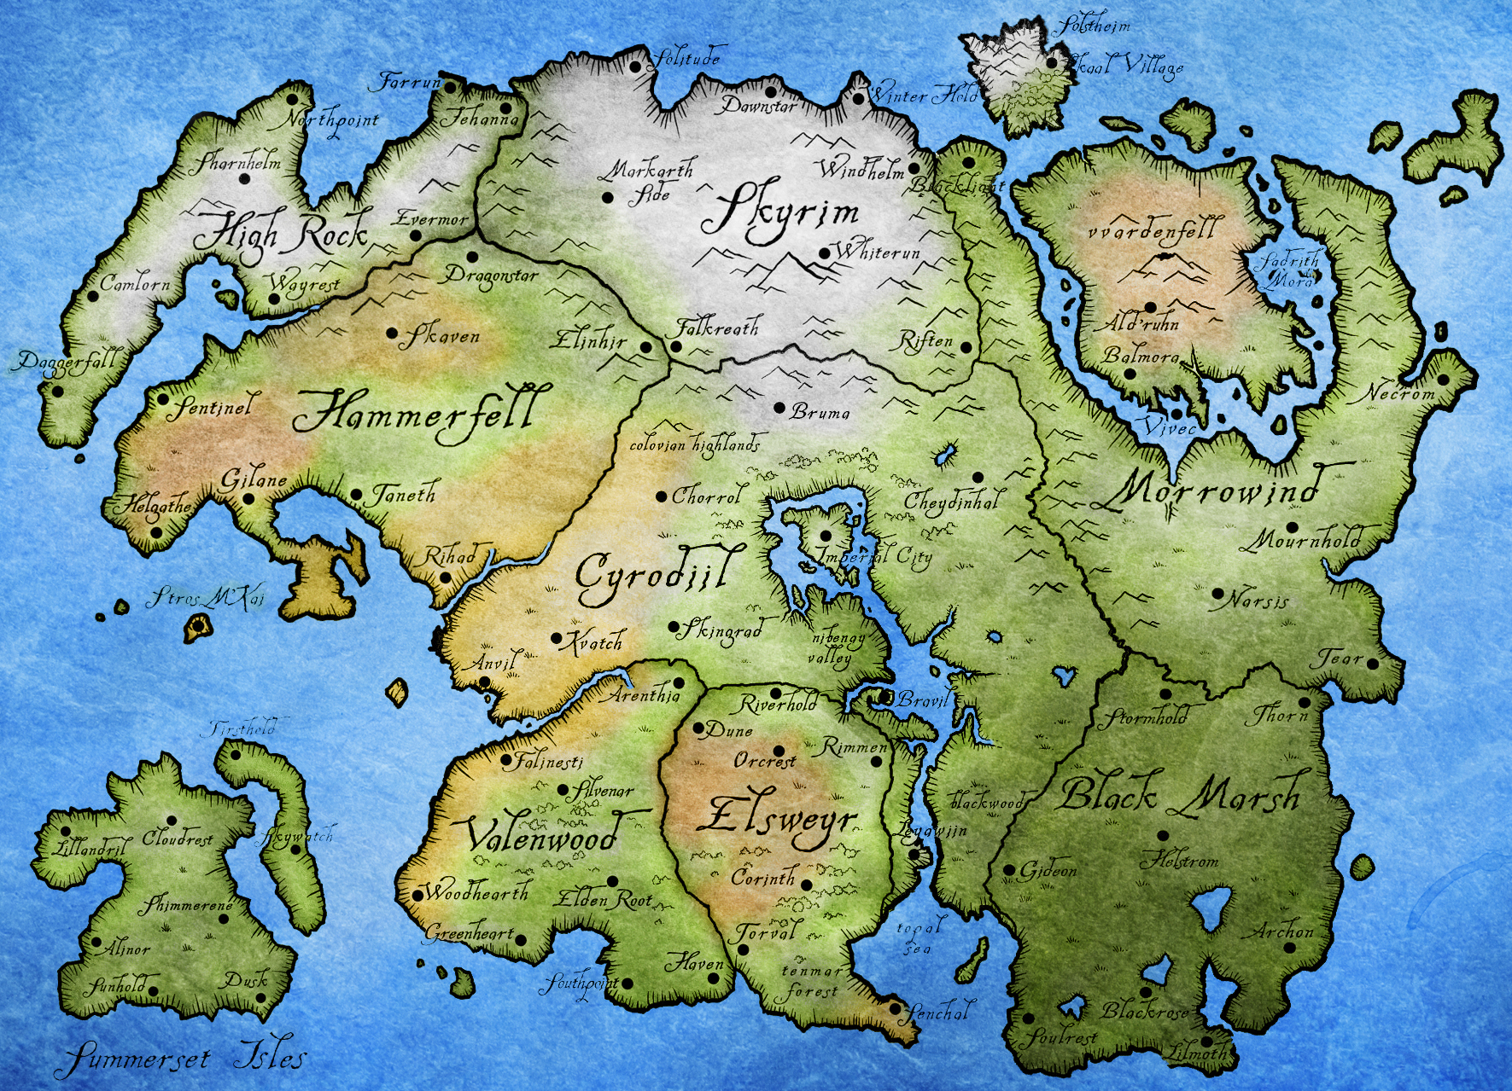

Slide 21
Maps
“The design and terrain of a location often corresponds to the events that take place there and to the worldviews of its inhabitants” (158)

Slide 22
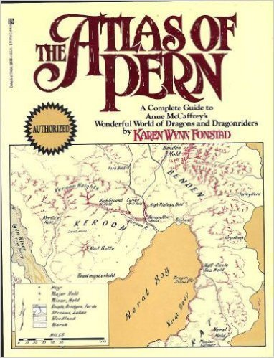

Slide 23
“Duration or span of time in which events can occur”

Slide 24
“Timelines organize events into chronological sequences and histories which show how they are temporarily related”

Slide 25
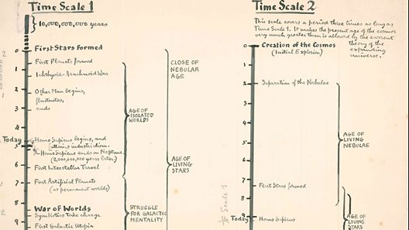
Timelines

Slide 26
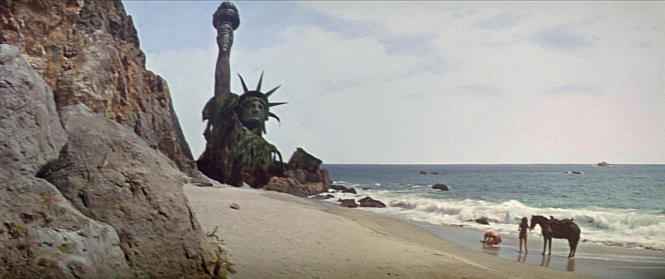
Time abyss

Slide 27
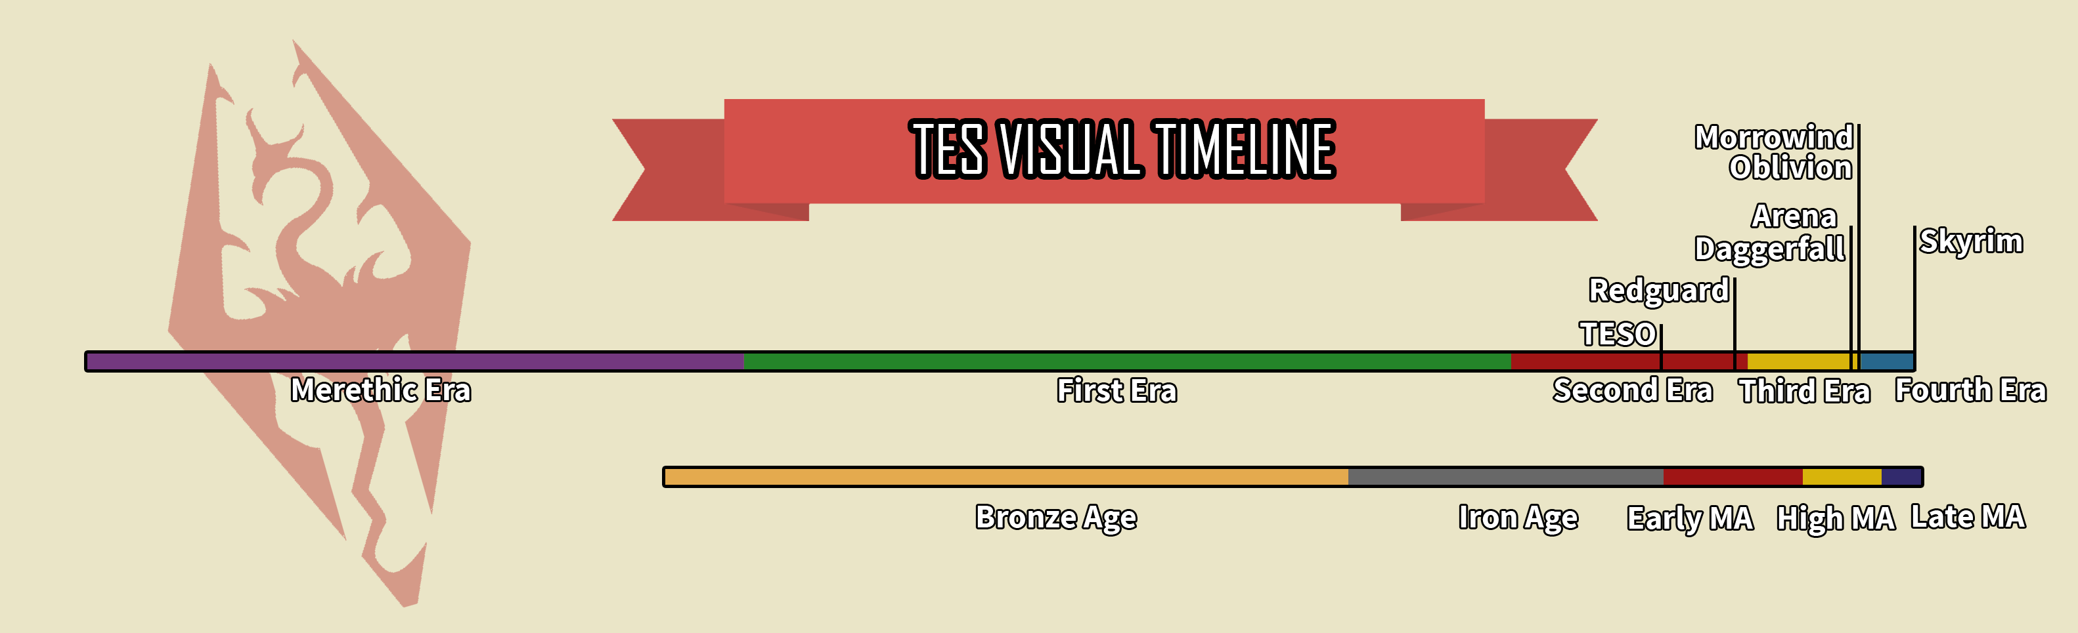

Slide 28
“A character or characters who can be said to be inhabiting the world”

Slide 29
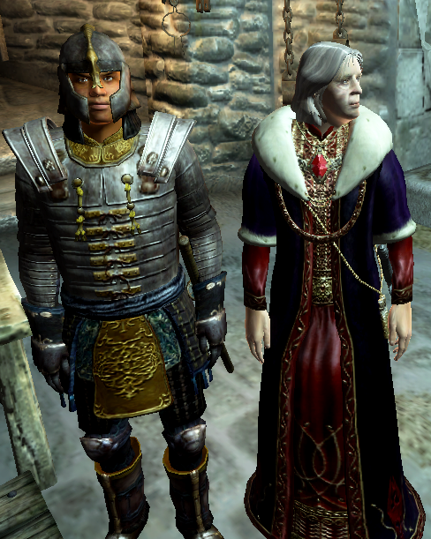

Slide 30
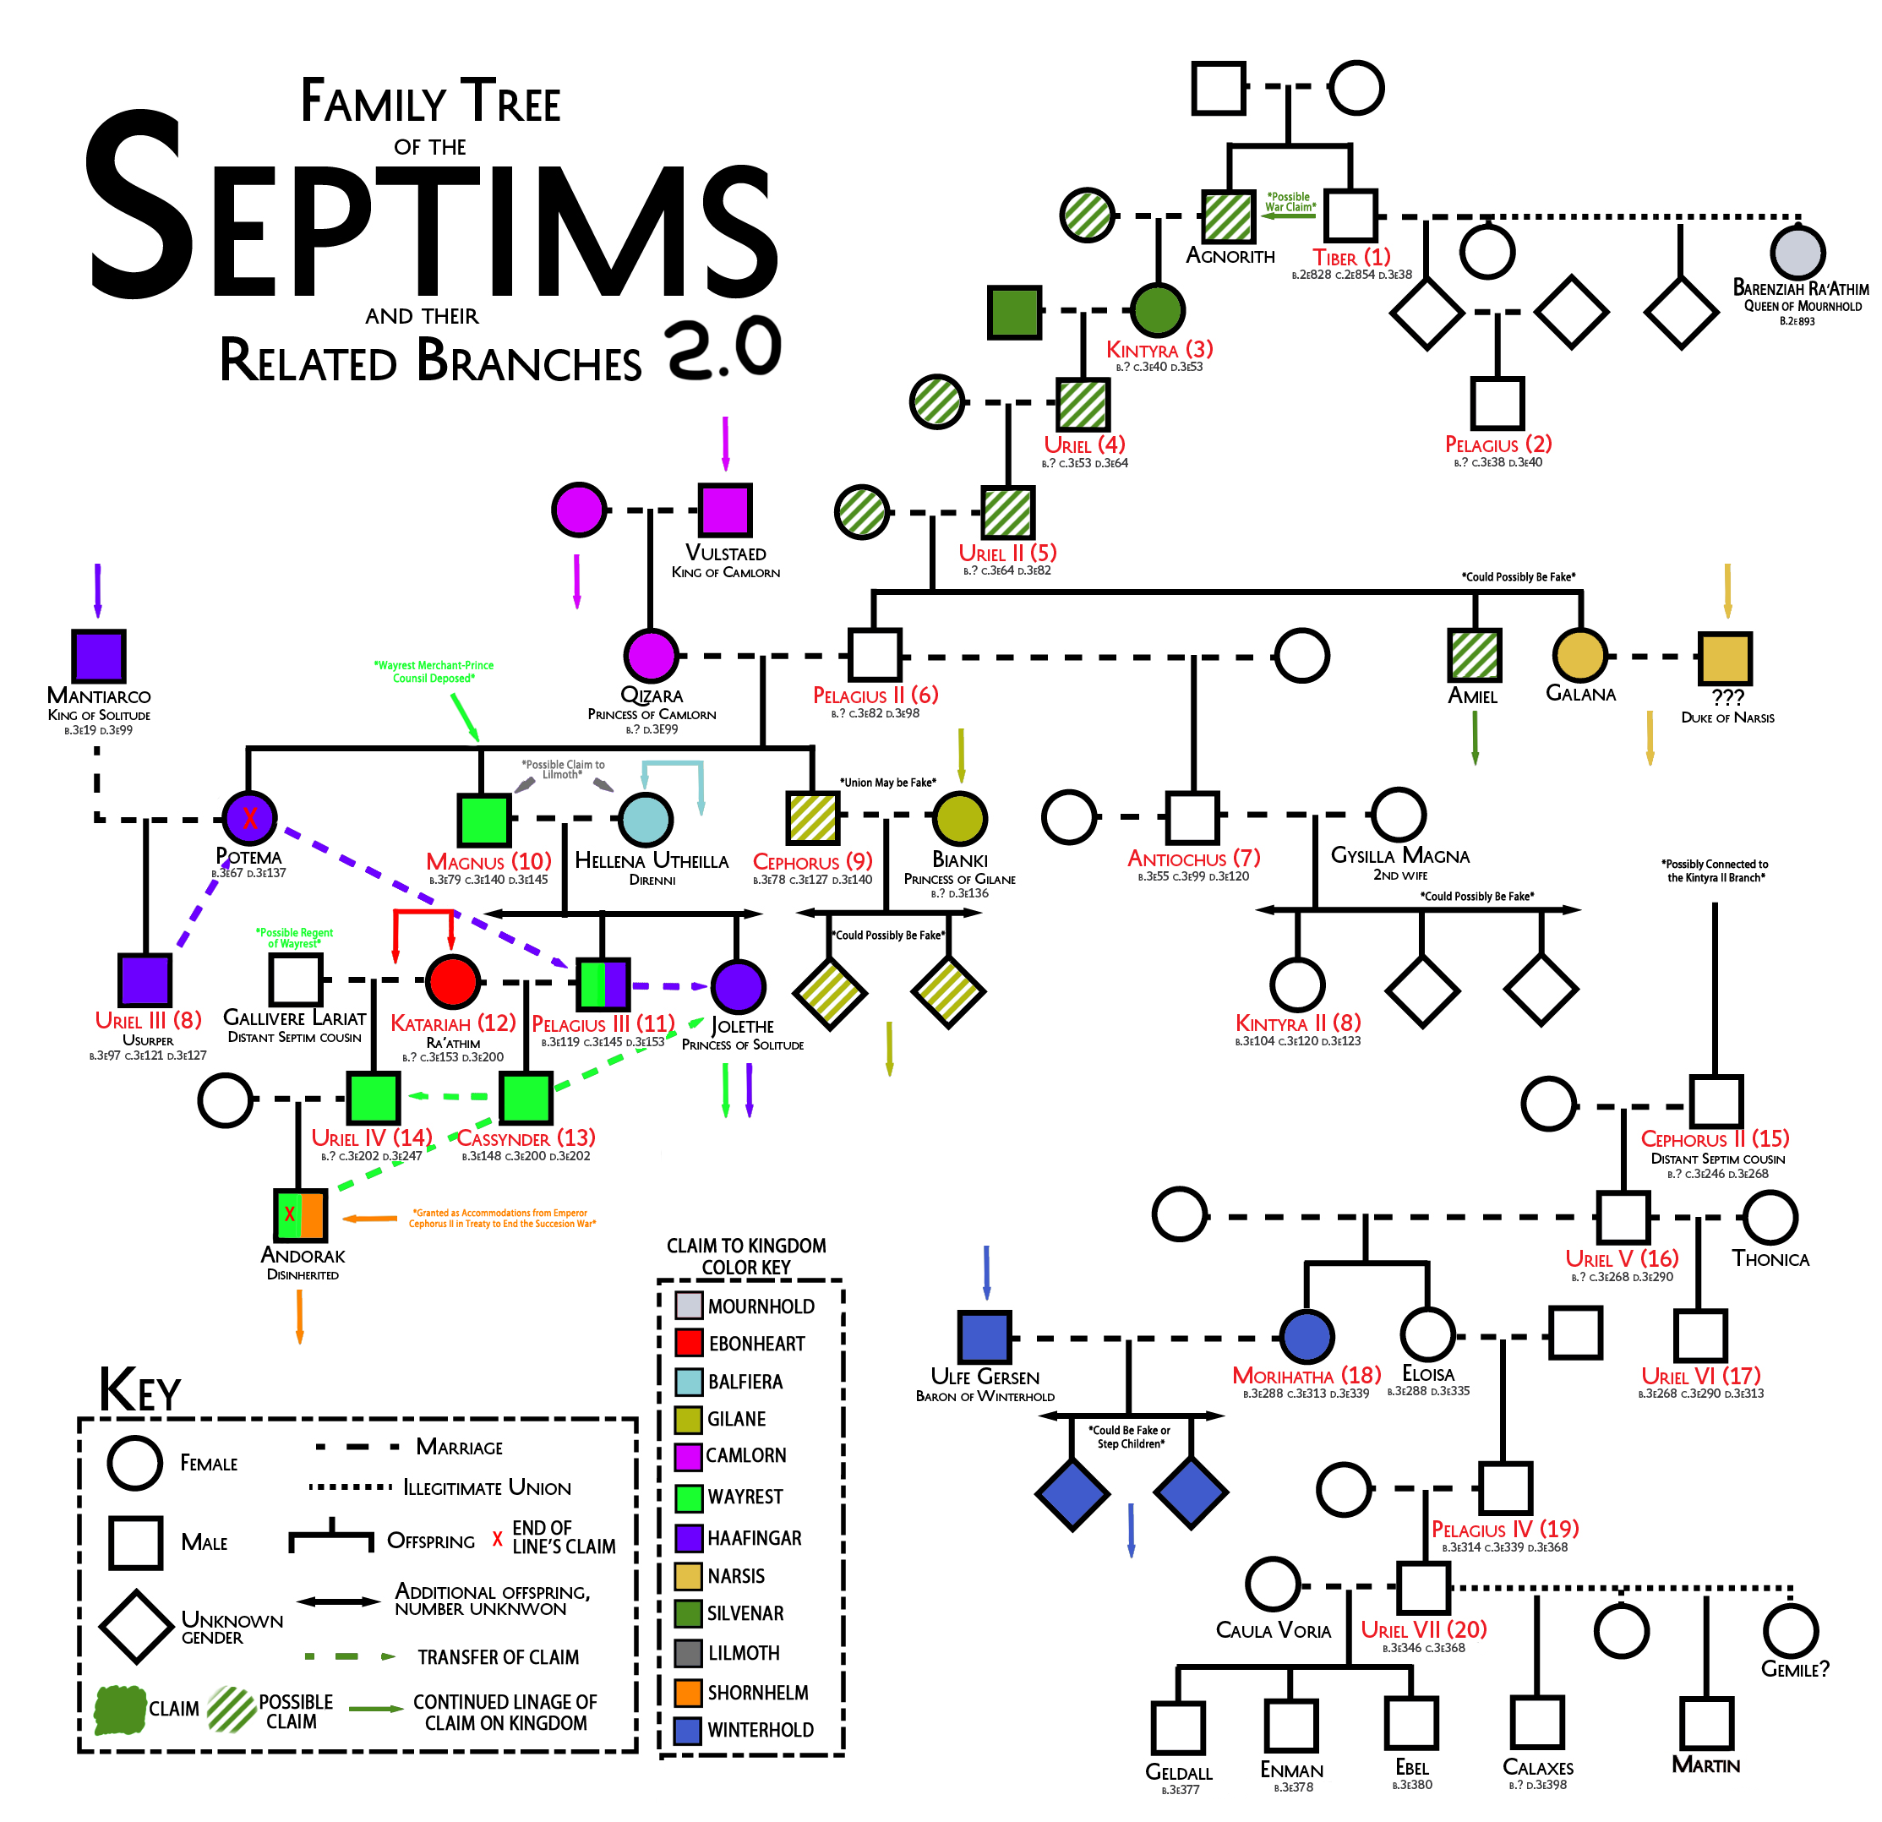

Slide 31
“Genealogies show how characters are related to each other (the term can be applied more broadly than merely biological kinship)”

Slide 32
Nature (flora, fauna, physics)
Culture (built on top of nature by inhabitants)
Language (arises from culture and expresses culture’s worldview)
Mythology (combines previous layers and how culture understands)
Philosophy (set of worldviews arising from the world itself)

Slide 35
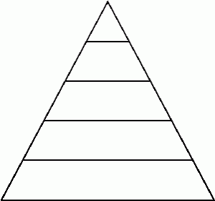
Philosophy
Mythology
Language,
Culture
Nature
Theme & Tone

Slide 36
Tone
How the world feels
Grimdark
Hopepunk
Light and whimsical
Bleak and depressing

Slide 37
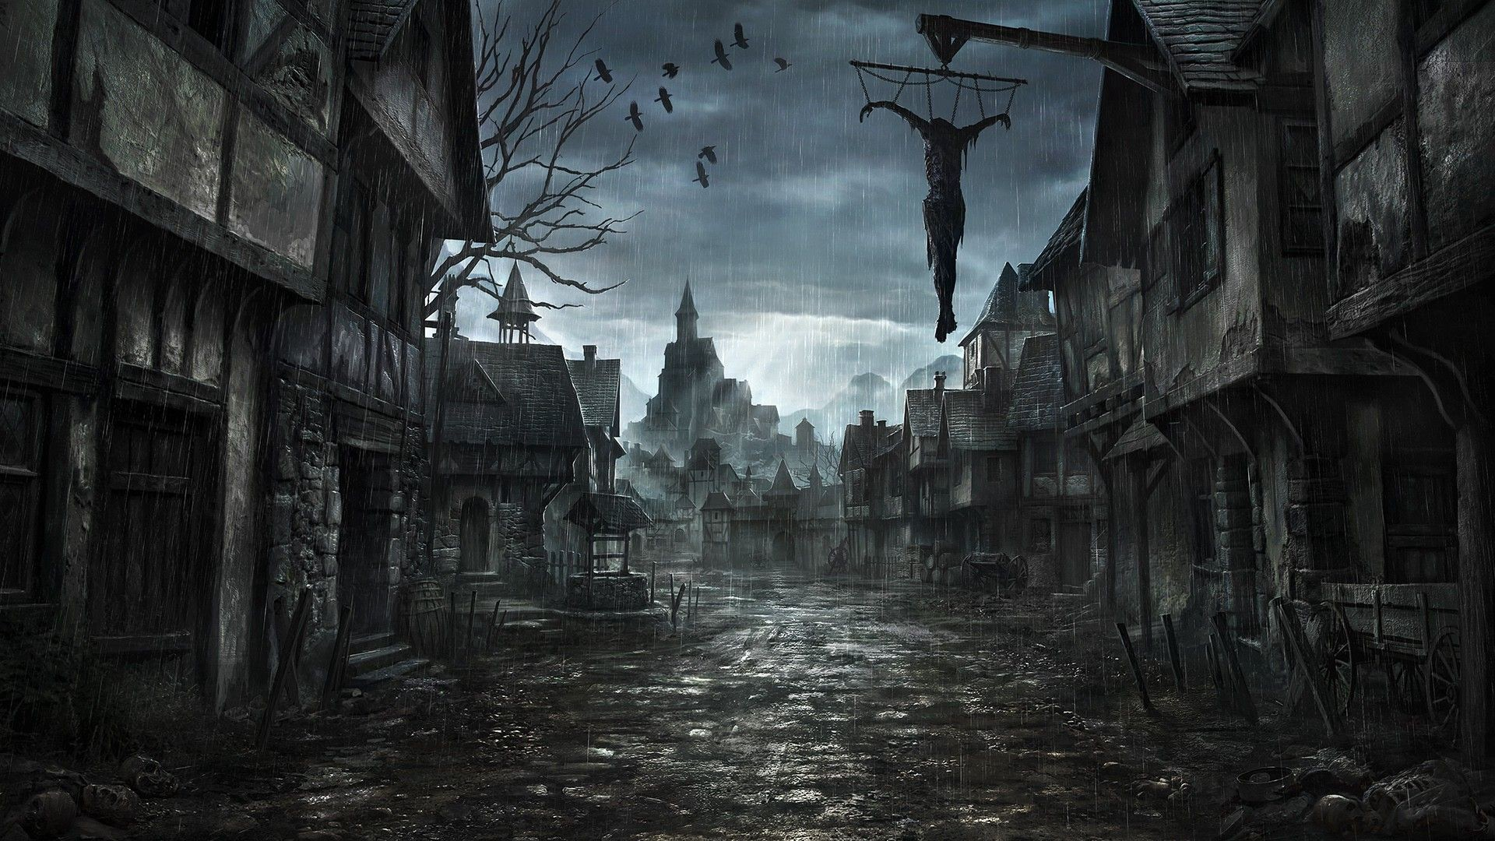
Grimdark tone

Slide 38
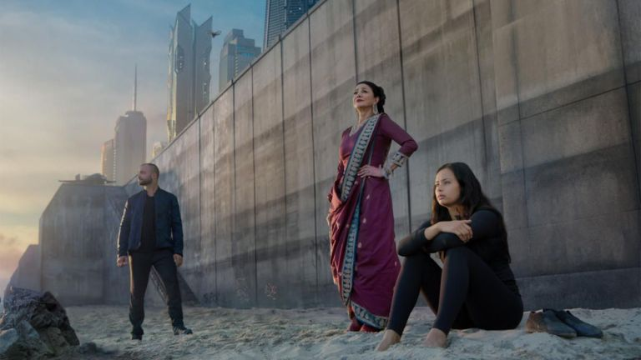
Hopepunk

Slide 39
Theme
What the world is about (ideas, concepts)
A search for freedom
Self-knowledge
Anarchy
Solipsism
Scarcity of resource

Slide 40
Nature
“The materiality of a world, its physical, chemical, geological, and biological structures and the ecosystems connecting them” (172).

Slide 41
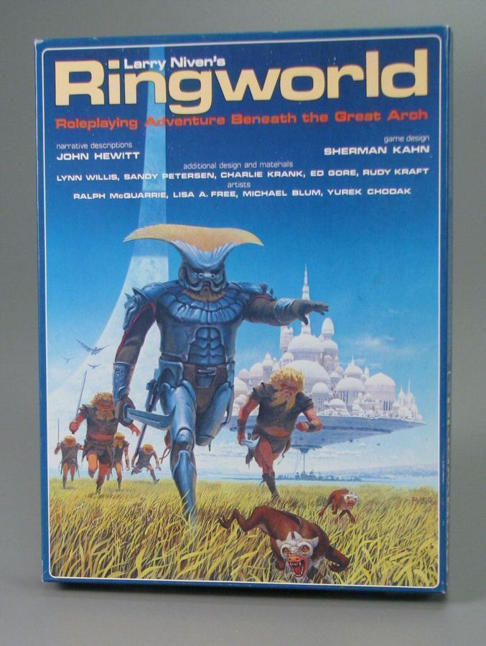
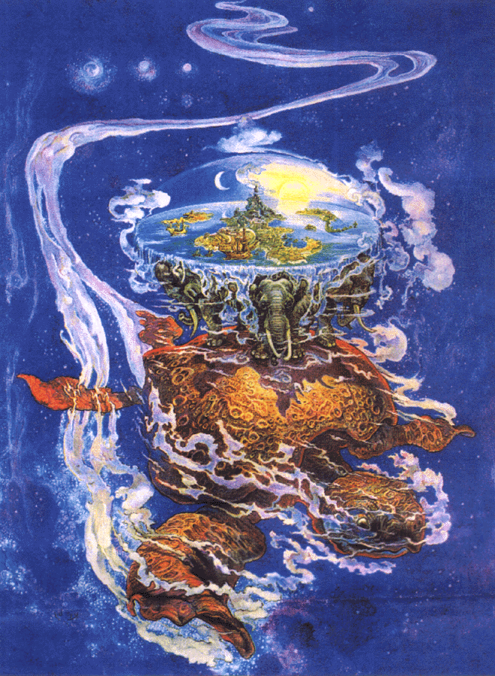
Structure of the world: globe, disk, ring

Slide 42
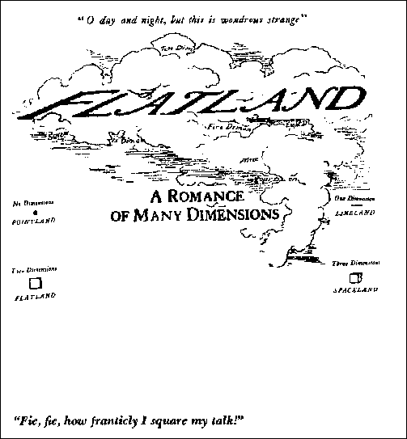
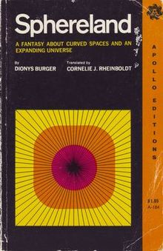
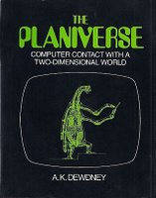
Different dimensionality

Slide 43
“Some video game worlds event let players experience alternative physical laws . . .” (174-75)

Slide 44
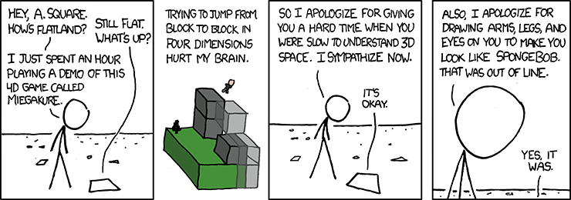

Slide 45
Or Fez, or Monument Valley, or Manifold Garden, or . . .
Borderlands (very little gravity damage, 2d/3d): Inversion (change the way world works, instead of falling straight down), VVVVV (instead of jumping, you flip), Marble Blast Ultra (there is jumping, but in some sections you get on different gravity platforms), Sonic (run super fast),

Slide 46
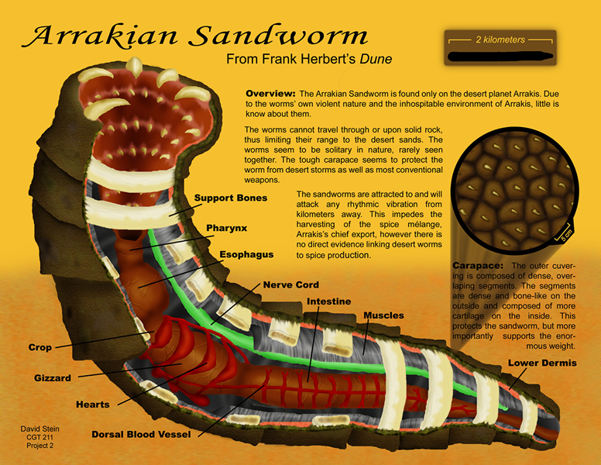
Flora and fauna “used to solve worldbuilding problems”

Slide 47
Color
Jale
Ulfire
"Just as blue is delicate and mysterious, yellow clear and unsubtle, and red sanguine and passionate, so he felt ulfire to be wild and painful, and jale dreamlike, feverish, and voluptuous.“ (David Lindsay, Voyage to Arcturus)
Octarine (the colour of magic)

Slide 48
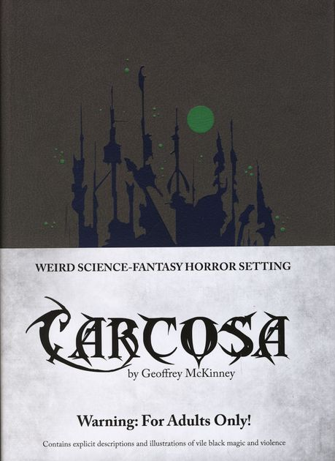
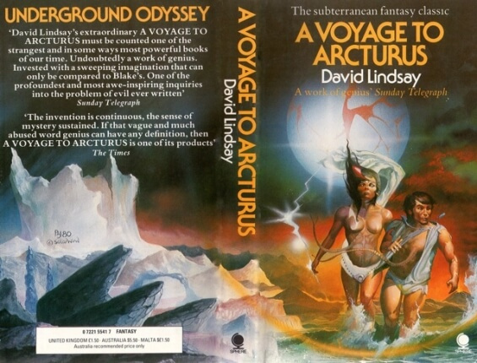
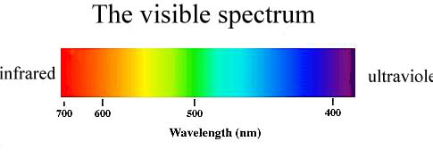

Slide 49
Culture
“Culture links nature to history and is usually central to the unique situation that provides a story’s conflict” (179)

Slide 50
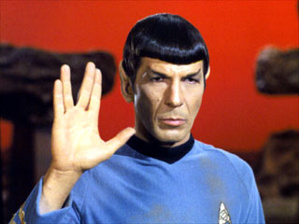
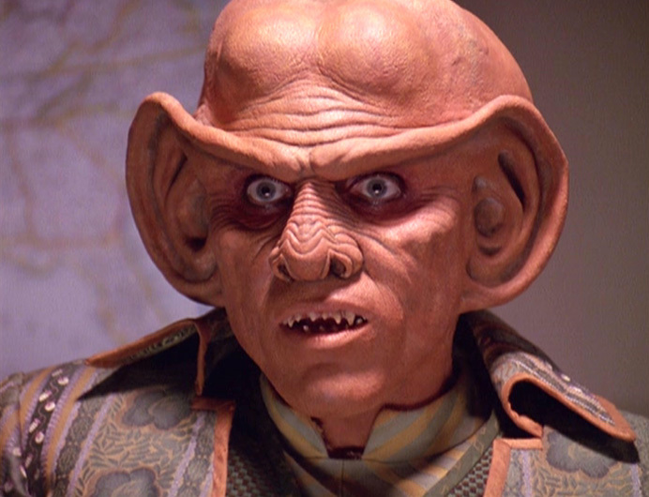
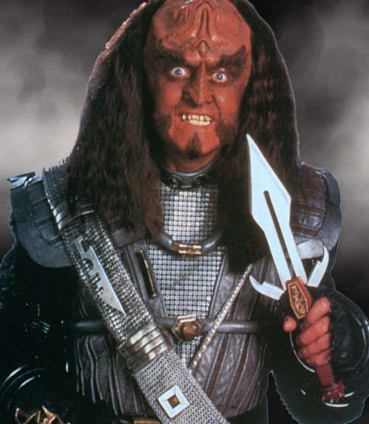
Multiple clashing cultures

Slide 51
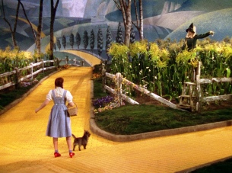
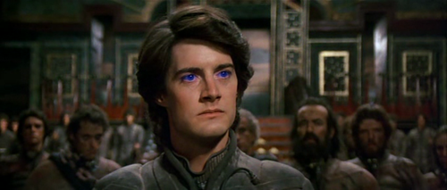
An outsider from another world who allies with the secondary world as a savior . . .

Slide 52
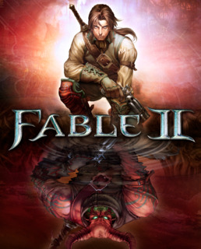
But be careful, because there are dark (imperialist) sides to this myth

Slide 53
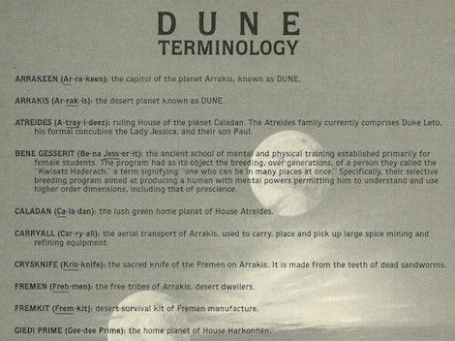
Language establishes concepts unique & central to a world and its cultures

Slide 54
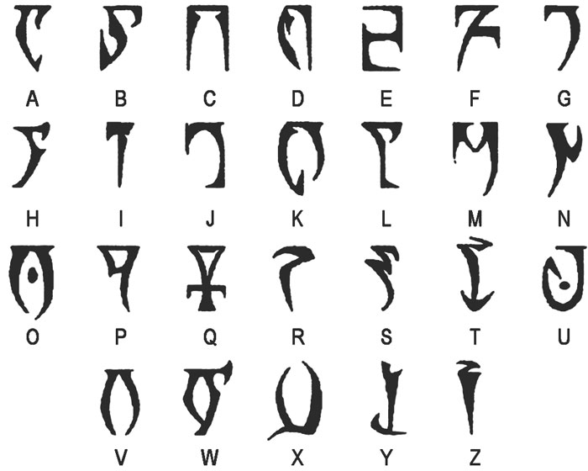
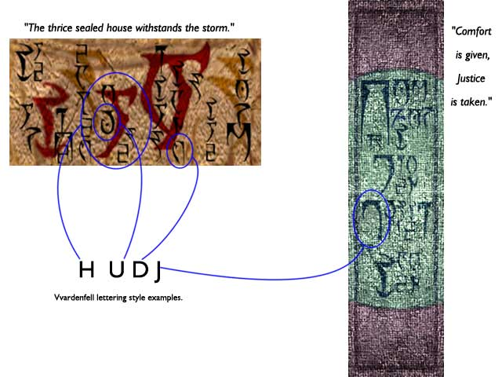
The physical structure of written language reflects the character of a culture & its material circumstances

Slide 55
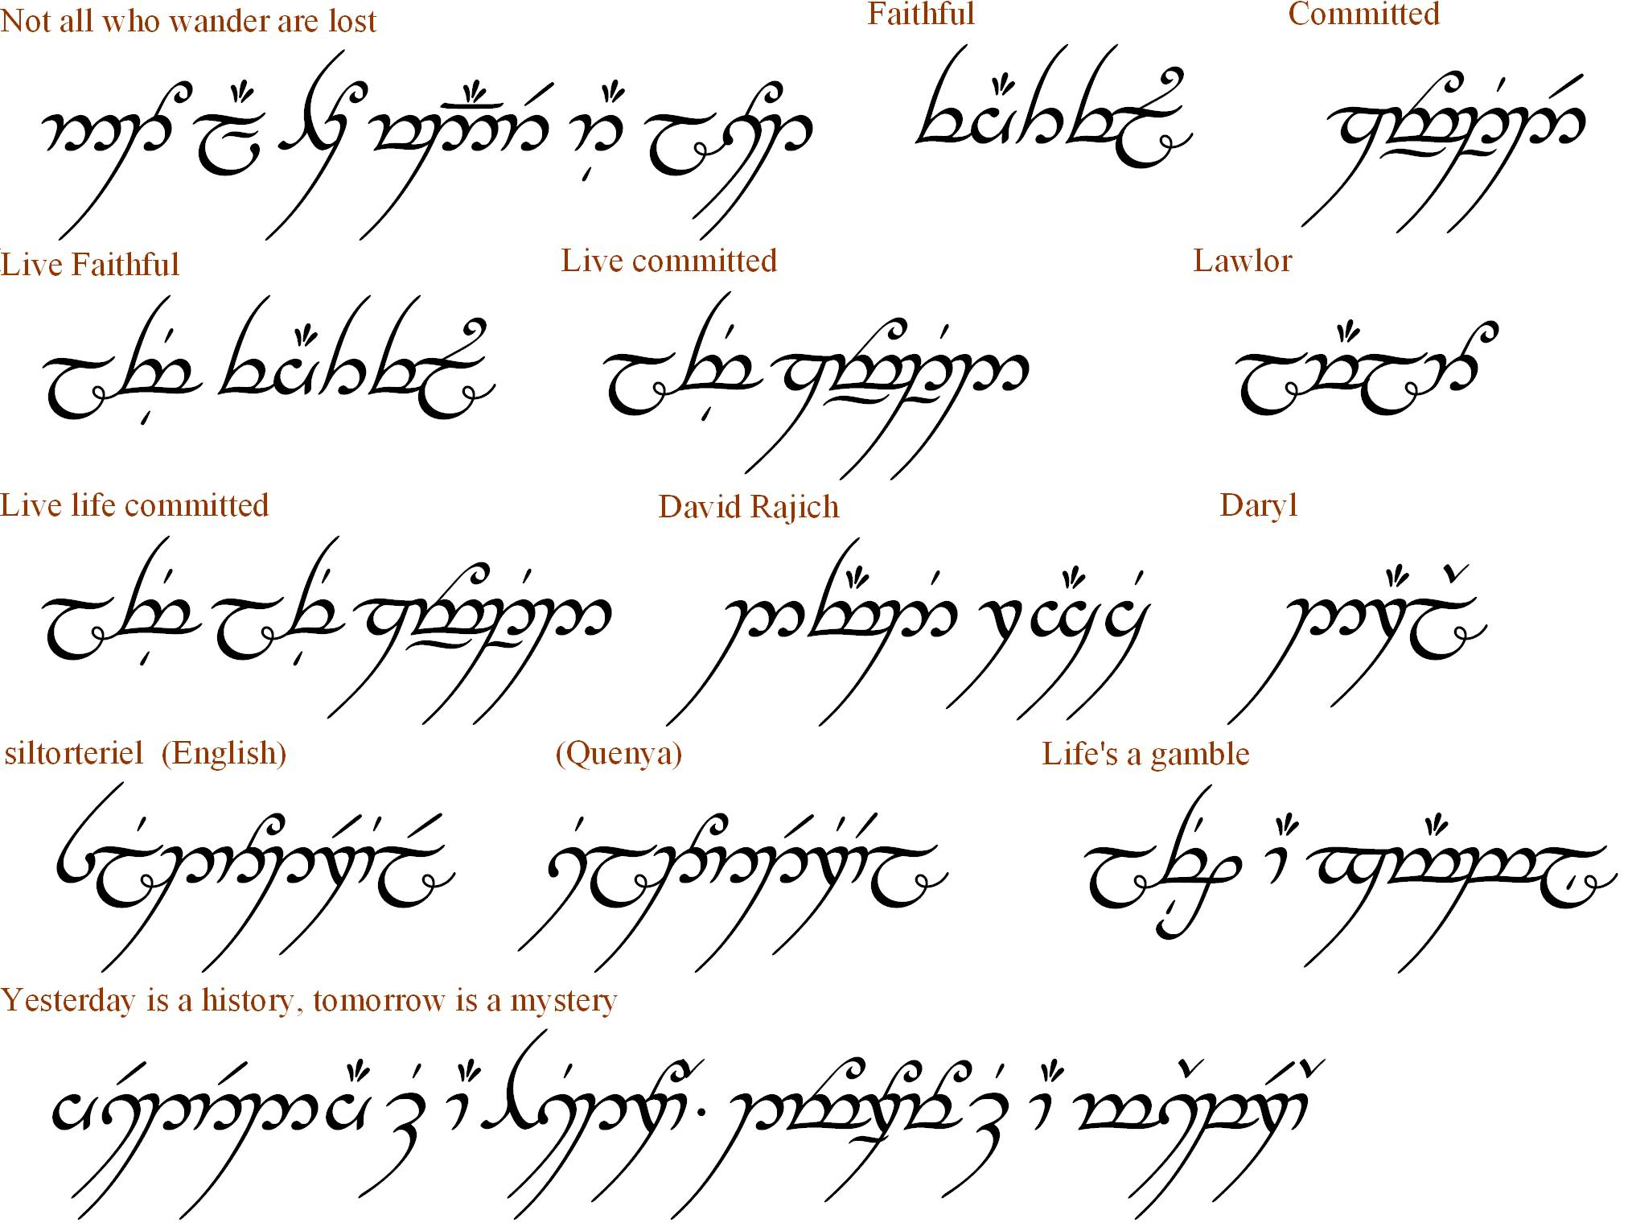

Slide 56
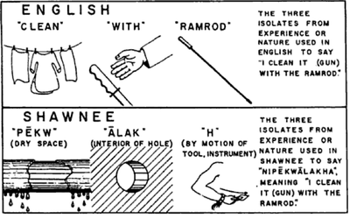
Language shapes & structures thought

Slide 57
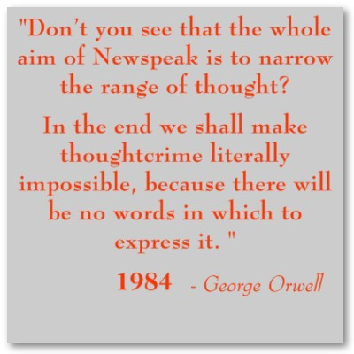
Language shapes thought

Slide 58
Language
Con Langs (Constructed Languages)
A posteriori
A priori

Slide 59
Problem: Language Barrier
Solutions?

Slide 60
Common tongue
Sped-up acquisition
Acquisition during ellipsis
Universal translator

Slide 61
Language Construction Kit (Mark Ronsenfelder)
http://www.zompist.com/kit.html

Slide 62
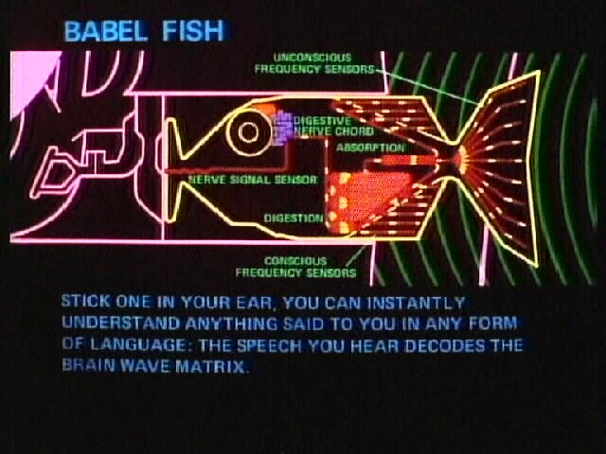

Slide 63
Mythology (how cultures understand metaphysics)
Creation
Apocalypse
Pantheon
Cosmogony

Slide 64
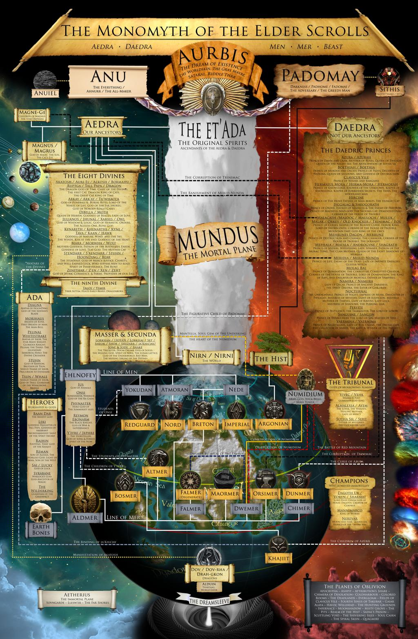

Slide 65
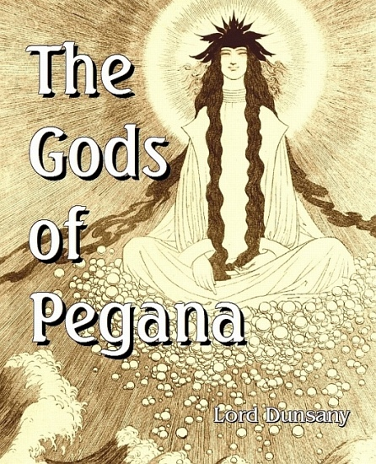

Slide 66
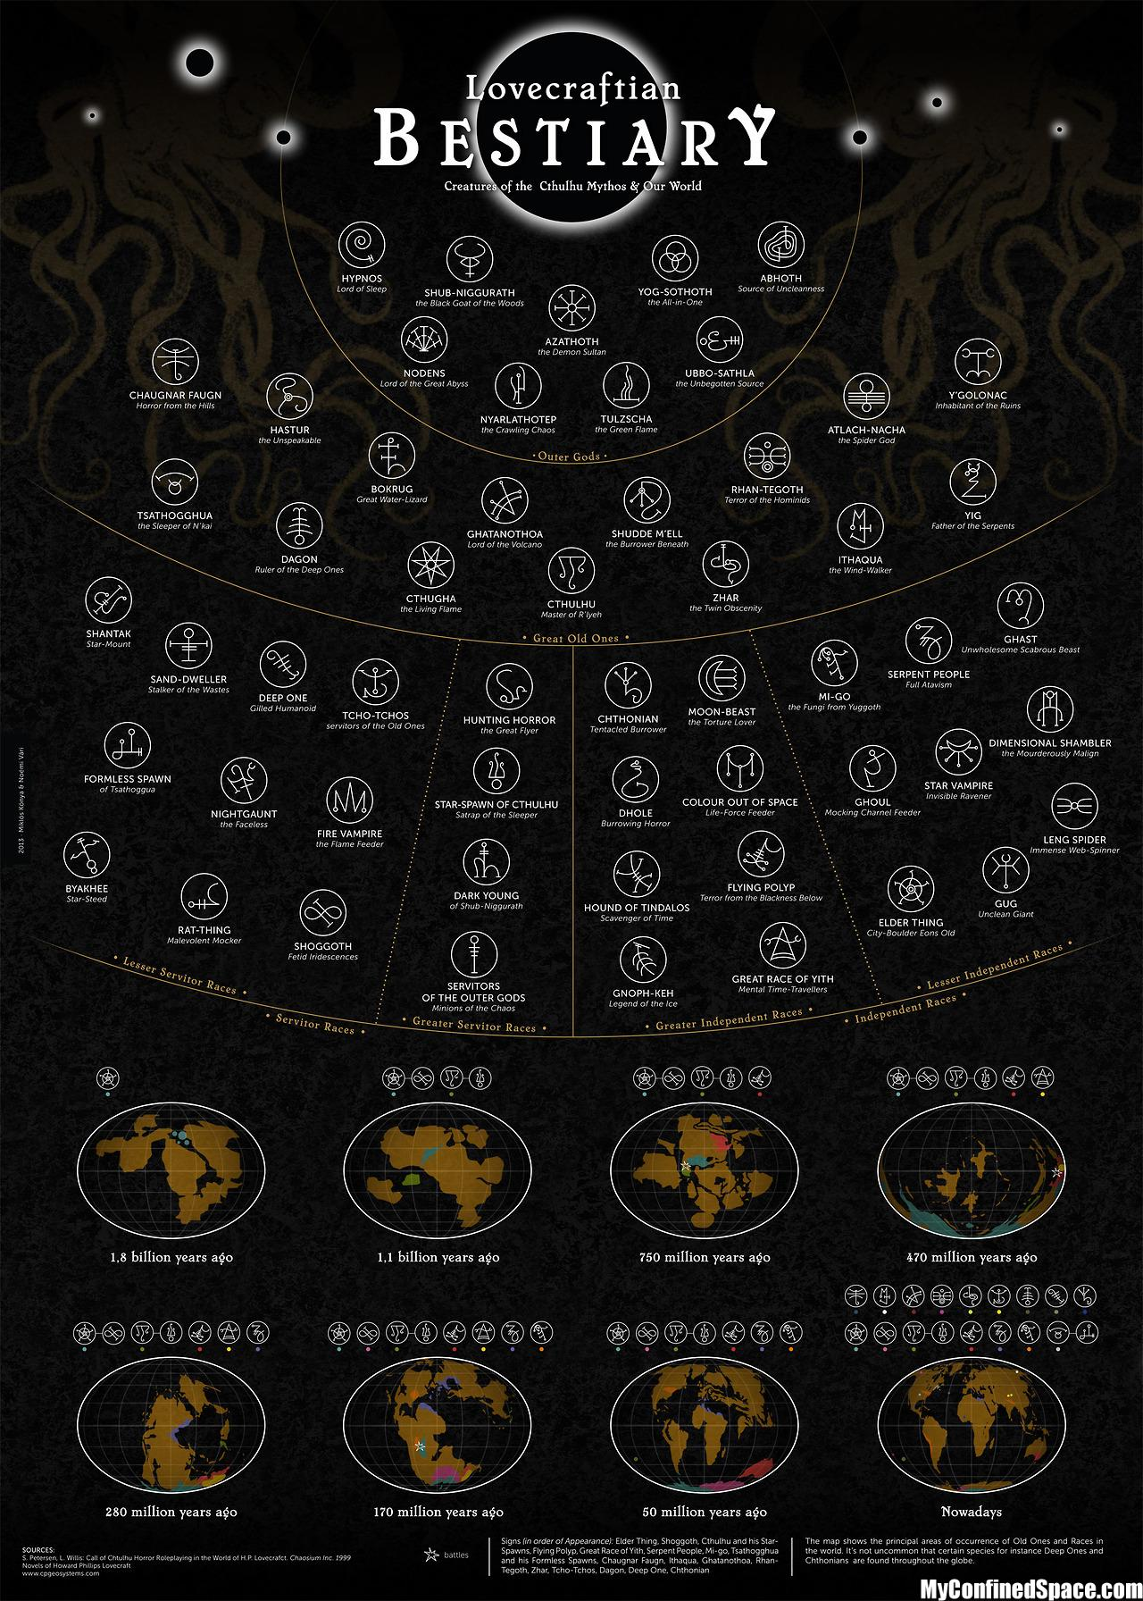

Slide 67
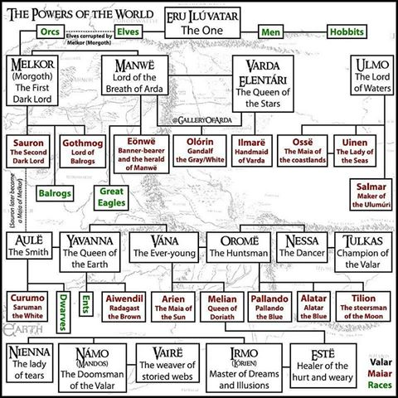

Slide 68
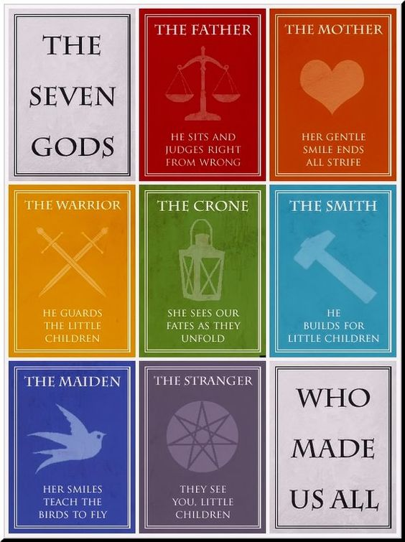

Slide 69
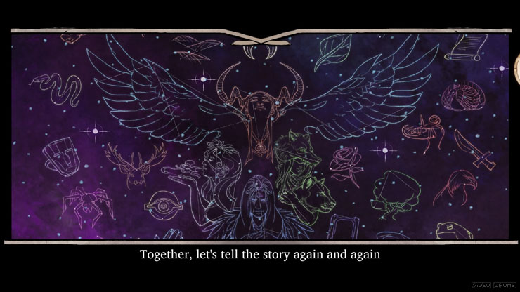
Moonhunters (procedurally generated mythology)

Slide 70
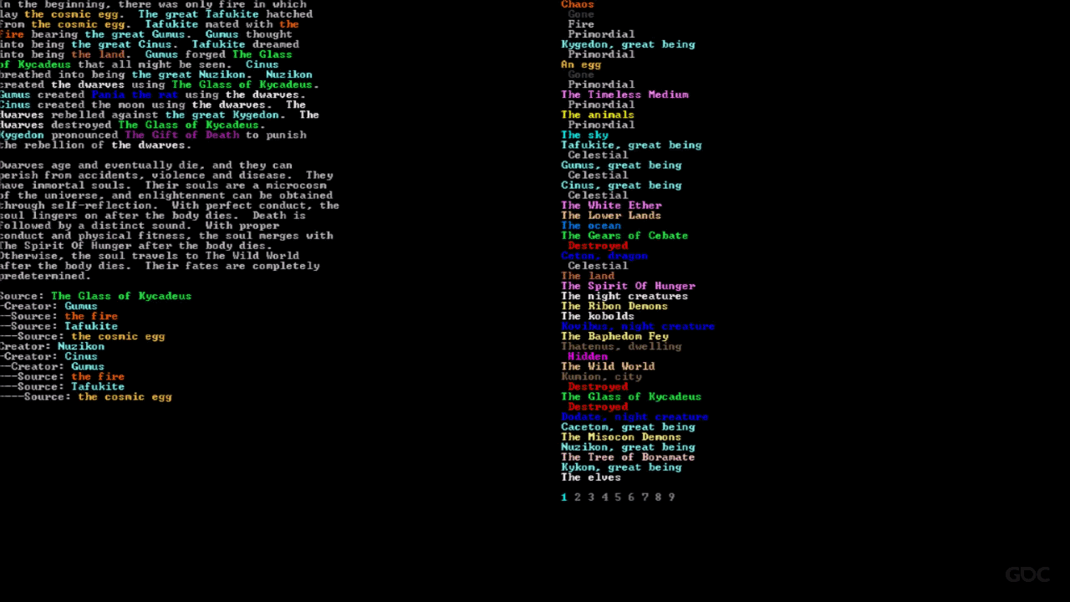

Slide 71
Philosophy
Nihilism
Atheism
Roman Catholicism
Aestheticism
Jungianism and Taoism

Slide 72
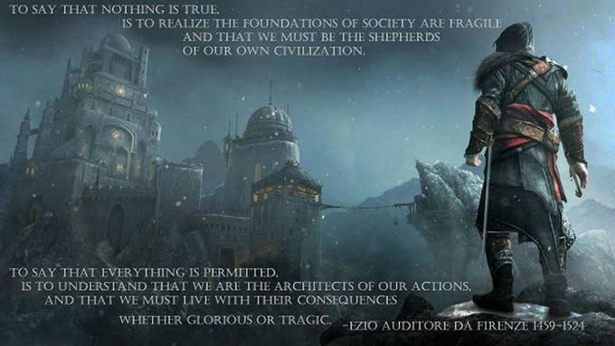

Slide 73
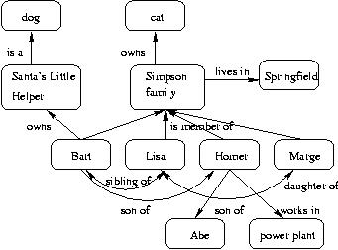
Ontology: what exists in your world and how is it structured?

Slide 75


Slide 76
On a whiteboard or large sheet of paper, map out the ontology of your world. Include important classes of object and objects, including gods, people, plants, animals. Base your kinds on existing kinds whenever possible. Then, break down each kind into its properties (the things that it always & usually is). Lastly, test your ontology by listing instances of each kind. Do they fit into the categories, or do they require many special cases/exceptions? If the latter, continue to think out your ontology

Slide 77
Kinds
Map out the kinds of things that are important in the world of your project
Anything important that is mentioned in your world should belong to a category
Reverse engineering story into objects, properties, verbs

Slide 78
Properties
What properties do the kinds in your world have?
(e.g. vehicles are always enterable, containers are usually openable)

Slide 79
Rules
What rules should govern their behavior?
(Instead of hitting a god, kill the player with a bolt of lightning.
Instead of taking a cat, the cat runs away.)

Slide 80
Instances
What are some key instances in your world?

Slide 81


Inform7 (a useful world prototyping tool: object-oriented declarative programming language that foregrounds ontology)

Slide 82
Characteristics of a good world pitch
Clearly explained, thematically resonant core experience, tone, and theme
Close, clearly-explained relationship between game mechanics and the narrative background that gives them meaning and purpose
Invention (creative substitution of primary world defaults for thematic, aesthetic, & mechanical ends)
Cohesion (i.e. a world that fits together to create a unified experience)
Completeness (i.e. ability to answer important questions about your world)
Creation of enigmas, when appropriate (gaps deliberately left in the player’s understanding of the world in order to promote active imaginative engagement)
Compelling, concrete, and vivid writing
Professional style and careful proofreading, including correct grammar and mechanics

